Slide 1
Various Problem Solving Approaches

Slide 2
Problem solving by analogy
Very often problems can be solved by looking at similar problems. For example, consider the problem of adding two 1x3 matrices A and B. The matrices are made up of 1 row and 3 columns.
Let A = [ a₁₁ a₁₂ a₁₃] B =[ b₁₁ b₁₂ b₁₃].
Then A + B is
A + B = [a₁₁+b₁₁ a₁₂+b₁₂ a₁₃+b₁₃]

Slide 3
Problem solving by analogy
Suppose we have developed a program for adding the two matrices A and B. Then the program can be easily modified for matrix subtraction. All we need to do is to replace the + sign by the – sign.
A-B = [a₁₁-b₁₁ a₁₂-b₁₂ a₁₃-b₁₃]
In problem solving by analogy, we use a solution that solves an analogous problem.

Slide 4
Problem solving by brainstorming
Consider a scenario in a company, when it has got an additional project
To manage the extra work, a discussion is made between 3 employees of the company and they give different suggestions.
First participant suggests outsourcing the work
Second participant suggests to hire a new employee.
Third one suggest to share extra workload among employees
Weight age for each idea is given on the basis of cost, feasibility and ease of implementation, and how it will help other processes.

Slide 5
Problem solving by brainstorming
Generated idea | Low cost | Easy to implement and is feasible | Will help other processes | Total
Outsource to a vendor | 20 | 20 | 20 | 60
Hire a new employee | 30 | 10 | 10 | 50
Share the extra workload | 10 | 30 | 30 | 70

Slide 6
Problem solving by brainstorming
We see that hiring a new employee is the best solution since it has the lowest total score.
Brainstorming works by focusing on a problem, and then deliberately coming up with as many solutions as possible and by pushing the ideas as far as possible.

Slide 7
Problem solving by abstraction
Suppose we have a quadratic equation a*x^2 + b*x + c = 0.
Then a well-known result says that the roots of that quadratic equation are
X1 = ( -b + squareroot(b^2 -4*a*c) ) / (2*a)
X2 = ( -b - squareroot(b^2 -4*a*c) ) / (2*a)

Slide 8
Problem solving by abstraction
Suppose we have been asked to solve the equation a*y^4 + b*y^2 + c =0. Then substituting y^2 by x we get the quadratic equation a*x^2 + b*x + c = 0. We know how to solve this quadratic equation so we can also solve the equation
a*y^4 + b*y^2 + c =0.

Slide 9
Problem solving by abstraction
A computer program for the quadratic equation helps to easily obtain a computer program for a quartic equation.
Abstraction helps to simplify the original problem into problems which are simpler and for which we know the solution.

Slide 10
Problem solving by divide and conquer
Suppose we have the sorted array
1 4 6 7 12 13 15 18 19 20 22 24. Suppose we want to search for 20. We compare 20 with 13 which is in the middle of the sorted array and find 20 > 13.
Next we search for 20 in 15 18 19 20 22 24. We find 19 is the middle element of that list. Then we search for 20 in 20 22 24. We find 20 is the first element in 20 22.

Slide 11
Problem solving by divide and conquer
The technique we just described is called as binary search. Every iteration in binary search eliminates half of the remaining possibilities. This makes binary searches very efficient - even for large collections. Binary search is an example of divide and conquer.

Slide 12
Problem solving by divide and conquer
The Euclidean algorithm of finding the gcd of two integers is another example of the divide and conquer strategy.A divide and conquer problem solving strategy works by recursively breaking down a problem into two or more sub-problems of the same (or related) type, until these become simple enough to be solved directly. The solutions to the sub-problems are then combined to give a solution to the original problem.

Slide 13
Problem solving by exhaustive search
Suppose we have a Boolean expression
F(a, b, c) = ab`c` + abc` + ac`
One way of finding all the tuples (a, b, c) that yield true is to try out all the possibilities for the Boolean variables a, b, c.
This gives 2^3 possibilities.

Slide 14
Problem solving by exhaustive search
Suppose we have n variables then we get 2^n possibilities.
This is an example of exhaustive search.
Here the number of searches grows exponentially with n.
Exhaustive search is also known as brute-force search.

Slide 15
Problem solving by trial and error
Suppose we have to factor the polynomial x^2 + 4x + 3.
The original binomials must have looked like this:
(x + m)(x + n),
where m and n are integers.We need to figure out the values of m and n. The constant term of the original polynomial is 3, so we need m*n = 3.

Slide 16
Problem solving by trial and error
What integers multiply together to give 3? The only choices are 1 and 3, or perhaps -1 and -3.
The coefficient of the x term in the original polynomial is 4, so we also need
m + n = 4.
Since 1 and 3 multiply to give 3 and add together to give 4, we have m = 1 and n = 3. Therefore, we can factor our original polynomial as
(x + 1)(x + 3)

Slide 17
Problem solving by trial and error
If we let m = 3 and n = 1 we'll have the same factorization, except with the factors written in a different order. Either way is correct,
The problem was solved by the problem solving strategy of trial and error. Trial and error can be used for solving puzzles such as Sudoku.

Slide 18
Problem solving by backtracking
Suppose we have to arrange 8 queens in a chess board such that no two queens attack each other.
This puzzle is called the 8 queens puzzle.
We can solve this puzzle by considering partial candidates.
The partial candidates are arrangements of k queens in the first k rows of the board, all in different rows and columns.

Slide 19
Problem solving by backtracking
Any partial solution that contains two mutually attacking queens can be abandoned, since it cannot possibly be completed to a valid solution.
Backtracking is a problem solving strategy that can be applied only for problems which admit the concept of a "partial candidate solution" and a relatively quick test of whether it can possibly be completed to a valid solution.
Thus the 8 queens puzzle can be solved by backtracking. Backtracking is often faster than a brute force strategy.

Slide 20
Problem solving by backtracking
Any partial solution that contains two mutually attacking queens can be abandoned, since it cannot possibly be completed to a valid solution.
Backtracking is a problem solving strategy that can be applied only for problems which admit the concept of a "partial candidate solution" and a relatively quick test of whether it can possibly be completed to a valid solution.
Thus the 8 queens puzzle can be solved by backtracking.
Backtracking is often faster than a brute force strategy.

Slide 21
Eight queens problem
Algorithm:
Start with one queen at the first column first row
Continue with second queen from the second column first row
Go up until find a permissible situation
Continue with next queen

Slide 22
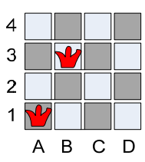
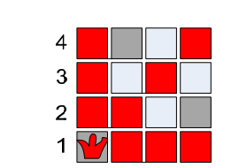
Eight queens problem
Red cells show ruled out cells
Placing First Queen Options for Second Queen
So the next queen Q2 has to options: B3 or B4
Choose B3

Slide 23
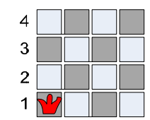
Eight queens problem
Red cells show ruled out cells
Placed two Queens Options for third Queen
No option for placing third queen
Back track and choose B4 for second queen

Slide 24
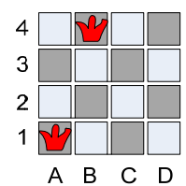
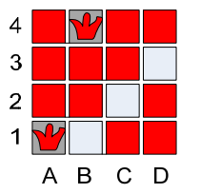
Eight queens problem
Red cells show ruled out cells
Change two Queens Options for third Queen
Third queen can be placed in C2
But Fourth queen cannot be placed else where
Backtrack and change position of first queen to A2

Slide 25
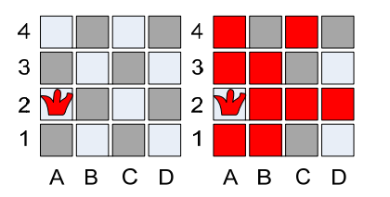
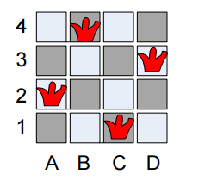
Eight queens problem

